Slide 1
PCS Securities Ltd.
Presents
LD Client Level Back Office Software

Slide 2
About LD-Client Level Software
LD Client Level is a LIVE Back-office Software for end Client which is directly connected to the main database
Client gets information regarding LD-Rakshak, LD – BO , LD-NSDL , LD-CDSL and LD-CCM under one login
With this software Client can get live updates regarding portfolio by sitting at any part of the world
Client can enjoy 33 different report with our software
As this software is develop using Silver Light Technology, client can enjoy graphical look & feel of the software
As the software has animation effects, it gives client feel of using latest technology even in stock broking business

Slide 3
Salient Features Of New Client Level Software

Slide 4
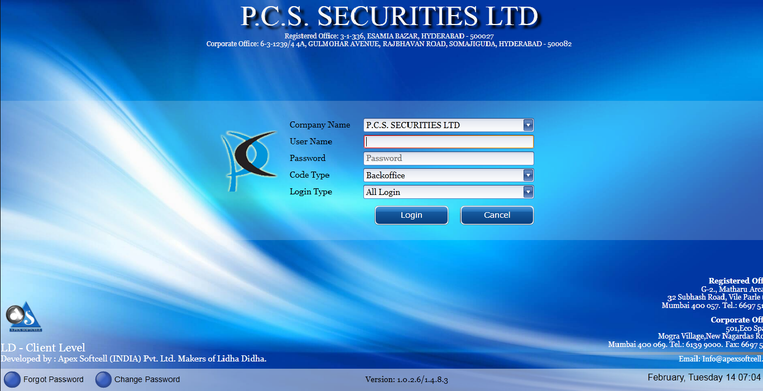
Login Screen
With animation effect availability of Login Screen

Slide 5
Single Sign In
A user with single login can view information of Trading back office, NSDL, CDSL and RMS (Rakshak)

Slide 6
Switching from One Firm to Another
A user can switch the firm (i.e. from equity form to commodity firm) under same login

Slide 7
Multiple Reports View
A user can open the multiple reports by using the menu button from the home page

Slide 8
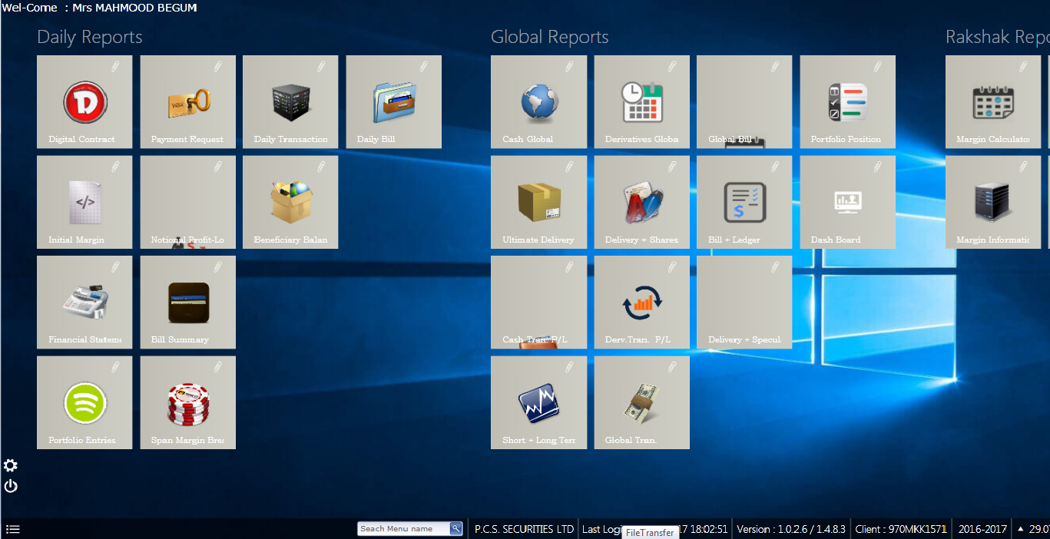
Reports Available under “Each Header”
Client can see all the daily transaction, Global Reports with nice explicit view

Slide 9
Reports Available under “Each Header”
Client can view all the global reports with advance user defined report viewing facility

Slide 10
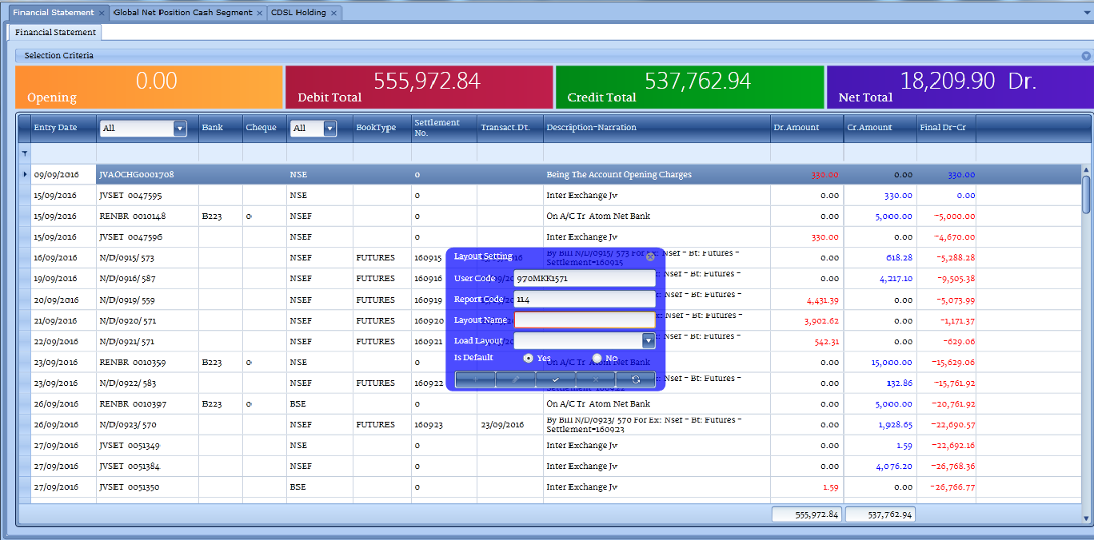
Layout Setting
A user has a facility in each and every report to add or remove columns and save as many layout as possible

Slide 11
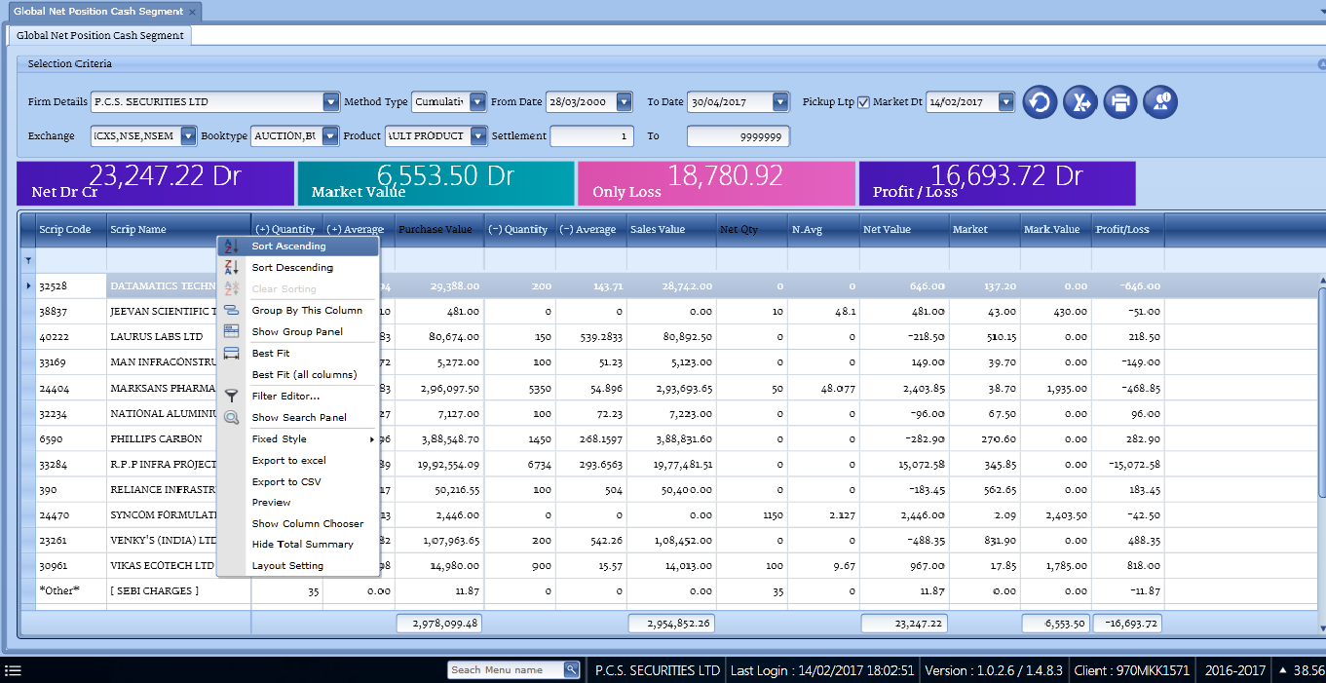
Data Sorting and Grouping
A user is provided with Excel facility where he/ she can sort or group the data by right clicking on header

Slide 12
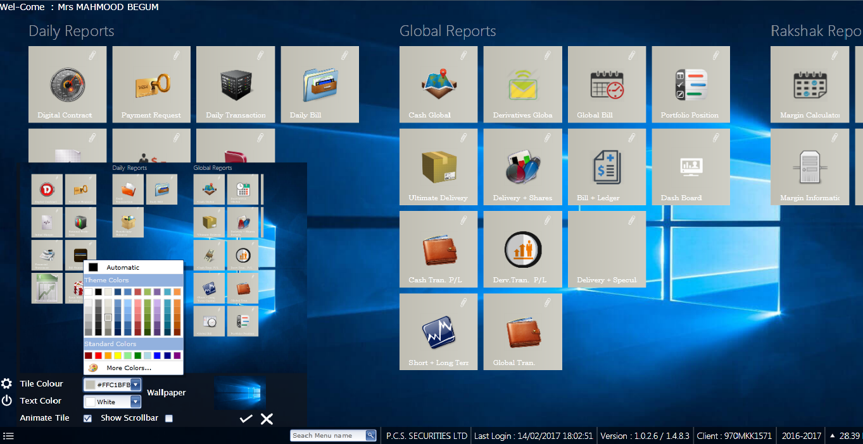
Theme Changing Facility
A user can change the theme of his/her account according to their preference

Slide 13
Glimpse Of Few Reports of Client Level Software

Slide 14
Client Snap Shot
Risk monitoring of margin and mtm position.
Client can see his Net Margin
Client can see his Financial Balance
Client can see his Demat Stock Value
Client can see his Collateral Value
Client can see his Cash Positions
Client can see his Stock Positions
Client can see his Live M2M Values
Client can see his F&O Positions

Slide 15
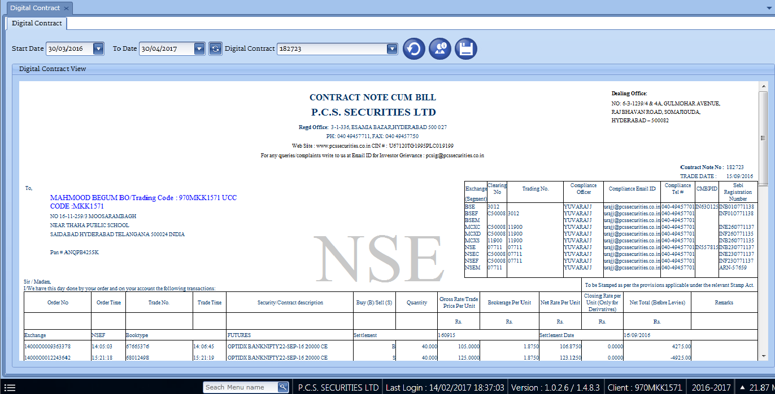
Digital Contract Note Cum Bill
User can view and Download Digital Contract Note Cum Bill for entire year

Slide 16
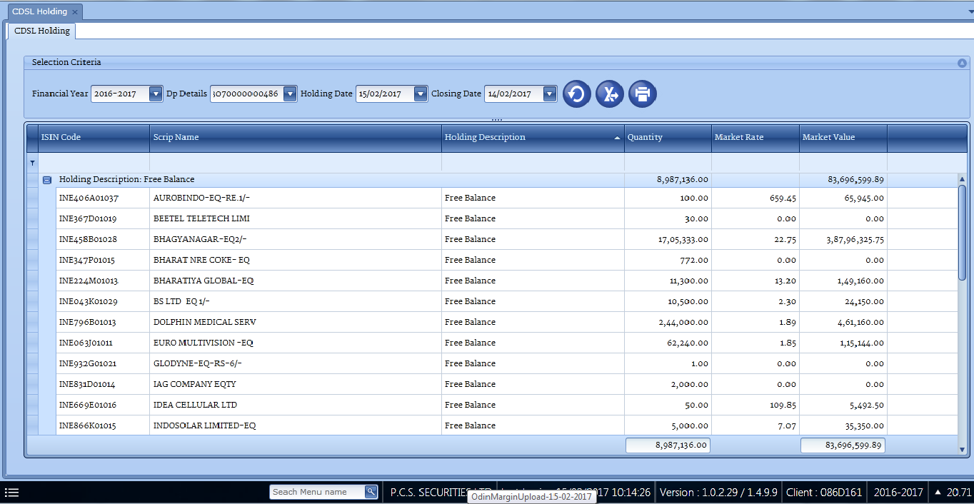
CDSL Holding
DP Holding-portfolio valuation with live market rates

Slide 17
Benefits to Brokers
Though this software is for end client but it is indirectly beneficial to Brokers
Brokers can attract their clients by using this technology especially Tech Savvy clients
Broker can give user define reports to their clients where client can add/remove columns, export data, filter the data
By the utility of “5 Favourite Reports” each client of broker can view his own set of reports daily. So broker need not have customise the same for each client
Broker can improve their brand image & do promotion by using our client level software

Slide 18
Benefits to the Ultimate Client
Ultimate Delivery Report: This report assists the end-client to know the
delivery status
Softcopy of KYC :- KYC are been maintained in soft copy as scan image
Digital Contract : - User can get entire year contract notes of any
segment
Short Term and Long Tern Capital Gain: - This report will assist the user
to calculate their Short Term and Long Term Capital Gain for income Tax
Purpose
Payment Request: User can make the payment request online from their
login without any hassle

Slide 19
THAN K YOU FOR YOUR PRECIOUS TIME !!!
Contact Us :-
Contact Name :- Abbas Hussain / Mohammed Sami
Contact No. :- 040-49457727 / 040-49457745
Email Address :- abbas@pcssecurities.co.in
sami@pcssecurities.co.in
Office Address:- 6-3-1239/4 & 4A, Gulomar Avenue,
Raj Bhavan Road, Somajiguda,
Hyderabad - 500082, Telangana,
INDIA Ph : 040-49457711

